Slide 1
Application Security

Slide 2
Objectives
Types of applications
Application models and technologies
Application threats and countermeasures
Security in the software development life cycle
Application security controls
Databases and data warehouses

Slide 3
Types of Applications

Slide 4
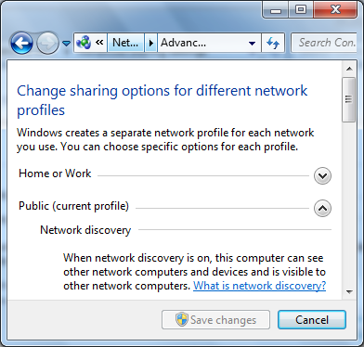
Agents
Standalone programs that are part of a larger application
Examples:
Anti-virus
Patch management
Configuration management
Windows 7's "Network discovery" agent

Slide 5
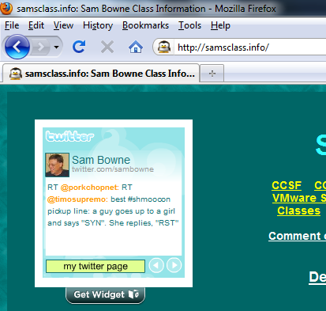
Applets
Software programs that run within the context of another program
Example: media players within browser

Slide 6
Client-server
Separate programs on clients and servers communicate via networks and work together
Client can be weak, even a "thin client" with no hard drive
Example: Client tools connect to database on server
Connection protocols: ODBC or Oracle's Net8 (called SQL*Net prior to Oracle8)
Few developed now but many are in use

Slide 7
Distributed
Software components run on several systems
User workstations, application server, records server, mapping server, databases…
Two-tier, three-tier, multi-tier
Reasons: scalability, performance, geographical

Slide 8

Web Applications
Web browser as client, application server back-end
Client software nearly universal
Application software centralized
Immensely popular and important
OWASP (Open Web Application Security Project) link Ch 3a

Slide 9
Application Models and Technologies

Slide 10
Application Models and Technologies
Control flow languages
Structured languages
Object oriented languages
Knowledge based languages

Slide 11
Control Flow Languages
Linear, sequential
Use of “if – then – else”
Branching with “go to”
Examples:
BASIC, COBOL, Cold Fusion, FORTRAN, Perl, PHP, Python, VBScript

Slide 12
Structured Languages
Nested, heavy use of subroutines and functions
Little or no “go to”
Examples:
C
Pascal

Slide 13
Object Oriented Languages
Utilize concepts of object programming
Classes, objects, instances, and inheritance
Methods, instantiations
Encapsulation, abstraction, polymorphism
Examples
C++, Java, Ruby, Simula, Smalltalk
Distributed Object Oriented Systems
Modules on different systems communicate with an Object Request Broker (ORB), such as
CORBA, Enterprise Java Bean, DCOM, or JRMI

Slide 14
Knowledge Based Applications
Knowledge-based systems
Artificial Intelligence
Used to forecast weather, stock prices, etc.
Neural networks
Modeled after biological reasoning processes
Artificial neurons that store pieces of information
Given cases about situations and outcomes, can predict future outcomes

Slide 15
Knowledge Based Applications (cont.)
Expert systems
Inference engine and knowledge base of past situations and outcomes
Accumulate experience and learn to work better

Slide 16
Threats to Applications

Slide 17
Reasons for attacks
Industrial espionage
Vandalism and disruption
Denial of service
Political / religious

Slide 18
Buffer overflow attacks
Disrupt a software application by providing more data to the application than it was designed to handle
Types
Stack buffer overflow
NOP sled attack
Heap overflow
Jump to register attack
Examples: Morris worm, ping of death, code red worm, Slammer, Blaster, Sasser

Slide 19
Buffer overflow attack countermeasures
Use safe languages and libraries
Executable space protection
Microsoft's Data Execution Prevention
Stack smashing protection
Uses a "canary" value to detect oveflows
Address Space Layout Randomization
Application firewalls

Slide 20
Malicious software
Types: viruses, worms, Trojan horses, rootkits, bots, spam, pharming, spyware, key loggers
Purpose
Steal, corrupt, or destroy information
Remote control
Denial of service

Slide 21
Types of malware
Virus: human assisted replication, embed in programs, files, master boot records
Worm: self replicating, scan for victims, rapid spread
Mass mailing, Port scanning
Trojan horse: claims one function, but is malware

Slide 22
Types of malware (cont.)
Rootkit: hide within or beneath the operating system
Hides files, processes, and network connections
Bot: remote control zombie
Spam: unsolicited e-mail

Slide 23
Types of malware (cont.)
Pharming: attack on DNS to redirect traffic to phishing Web site
Spyware: collect information about usage, forward to central server
Key logger: logs keystrokes and mouse movements, forwards to central server

Slide 24
Malware countermeasures
Anti-malware
Patches
Firewalls and application firewalls
Hardened systems
Intrusion detection systems
Decreased privilege levels
Penetration testing

Slide 25
Input attacks
Buffer overflow
Script injection
Cross site scripting
Cross site request forgery
Countermeasures
Input field filtering, application firewall, application vulnerability scanning, software developer training

Slide 26
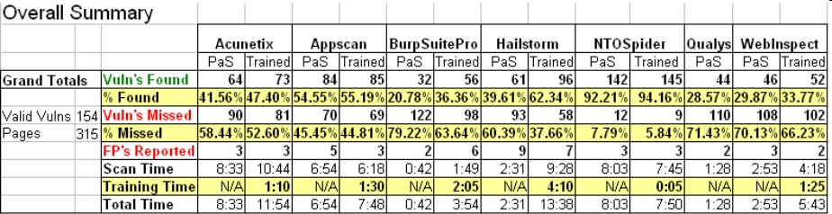
Vulnerability Scanners?
They miss 49% of the vulnerabilities they are looking for
Link Ch 6b

Slide 27
Object reuse
Use of a resource belonging to another process, including:
Memory, databases, file systems, temporary files, and paging space
Object reuse countermeasures
Application isolation
Server virtualization
Developer training

Slide 28
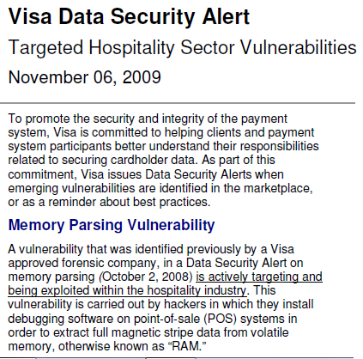
Link Ch 3c

Slide 29
Mobile code
Code from one system that executes on another system
Active Web content
ActiveX, Javascript, Flash
Downloaded software
Can be useful but some is malicious

Slide 30
Mobile code countermeasures
Anti-malware
Reduced user privileges
Don't surf the Web as administrator
Mobile code access controls
Don't let unauthorized users execute code
Restricting mobile code on workstations
Browser settings, NoScript, etc.

Slide 31
Social engineering
Attack on personnel to gain secrets
People are vulnerable because they want to help
Pretexting is pretending to be someone else
Social engineering countermeasures
Security awareness training that includes accountability

Slide 32
Back door / maintenance hook
Access holes deliberately planted by a developer
To facilitate easier testing during development
To facilitate production access
To facilitate a break-in
Back door countermeasures
Code reviews
Source code control

Slide 33
Logic bombs
Deliberate malfunction that causes harm
Time bombs
Malfunction on a given date and time
Event bombs
Malfunction on a specific event
Logic bomb countermeasures
Software source code review, external audits

Slide 34
Security in the Software Development Life Cycle

Slide 35
Security in the Software Development Life Cycle (SDLC)
SDLC
The entire collection of processes used to design, develop, test, implement, and maintain software

Slide 36
Security in the Software Development Life Cycle (cont.)
Security must be included in each step of the SDLC
Conceptual
Requirements and specifications development
Application design
Threat risk modeling
Coding
Testing

Slide 37
Security in the conceptual stage
Presence of sensitive information must be identified
Information flows
Access controls (users, administrators, third parties)
Regulatory requirements
Application dependencies

Slide 38
Security application requirements and specifications
Every detail of the software should be specified, down to individual input forms and fields
Security requirements
Roles, access controls, audit logging, configuration management

Slide 39
Security in application design
Adhere to all requirements and specifications
Published design documents
Design reviews
Reviewed by all stakeholders including security

Slide 40
Threat risk modeling
Identify threats and risks prior to development
Possible changes to specs, req’s, or design

Slide 41
Security in application coding
Develop safe code
Free of common vulnerabilities
Use safe libraries that include safe functions for input validation
1-10-100 rule
It costs 10 times as much to secure an application after it has been developed
It costs 100 times as much to secure an application after it has been implemented

Slide 42
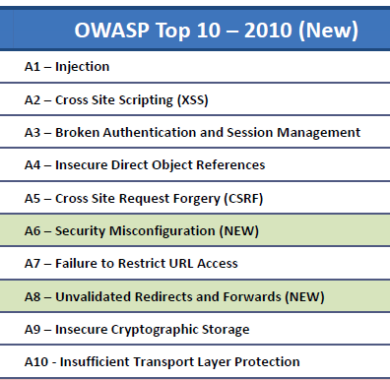
OWASP Top Ten Web Application Risks
Link Ch 6d

Slide 43
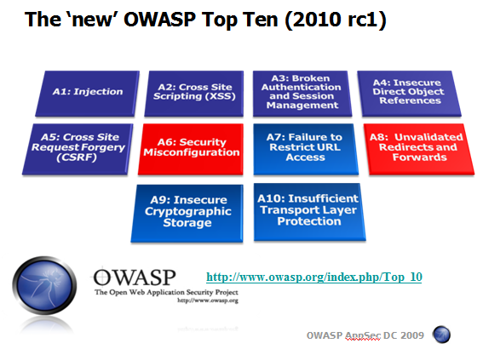
Great OWASP Presentation
Linked as an extra lecture on my CNIT 125 page

Slide 44
Security in testing
Testing should verify correct coding of every requirement and specification
Use vulnerability scanners

Slide 45
Protect the SDLC itself
Source code access control
Protect source code
Don't trust it to remain secret, though
Record version changes
Protection of software development and testing tools
Protect from unauthorized modifications
Protection of software development systems
Prevent introduction of malware, back doors, logic bombs

Slide 46
Application Environment and Security Controls

Slide 47
Controls that must be present in a developed application
Authentication
Limiting access to only legitimate, approved users
Authorization
Limiting access only to approved functions and data
Audit logging
Logging of all actions in the application

Slide 48
Databases and Data Warehouses

Slide 49
Database Concepts
Database
Ordered collection of data, such as employee records
Data Warehouse
A database used for decision support and research
May contain all customer transactions
Business intelligence tools analyze the data to find trends
Example: Google's ad-targeting data

Slide 50
Database Architectures
Hierarchical databases: tree structure like DNS (no longer produced)
Network databases: complex tree structure (no longer produced)
Object-oriented databases: OO, methods stored with data
Not common yet, see link Ch 3e

Slide 51
Database Architectures (cont.)
Distributed databases: physically distributed, any type
Relational databases (RDBMS): in widest use today
Data is stored in tables, records and fields
Tables have relationships
Oracle, SQL Server, DB2, MySQL, etc.

Slide 52
Database Transactions
Records retrieval
Records update
Records creation
Transactional integrity
Nested or complex transactions executed as a unit
Begin work… <transactions> …end work

Slide 53
Database Security Controls
Access controls
Userids, passwords
Table / row / field level access control
Read-only or read/write
Views
Virtual tables that are a subset of individual tables, or a “join” between tables
Permission given to views just like “real” tables

